Slide 1
INTERNSHIP PROJECT ON JAVA DATABASE CONNECTIVITY TOPIC: “EMPLOYEE MANAGEMENT SYSTEM”
NAME: NAVANEETH N
USN : 1RN21CS098
3rd SEMESTER
CSE-B

Slide 2
INTRODUCTION
The project ”Employee Management System” deals with handling the employee details and suggesting them a better tax regime to move into.
The system is built using Java, JDBC server and SQL to validate an employee’s details.
After the introduction of the new tax regime it has been difficult for the employees to choose the tax regime in which they pay minimum amount of tax.
Even though in the new tax regime there is no tax to be paid until the annual income of Rs.7,50,000, it can be disadvantageous once the salary rises above Rs 7,50,000. And it is also not feasible to change the tax regimes every financial year.
Considering all of them our main intention is to suggest the employee a better tax regime in which the tax to be paid is minimum.

Slide 3
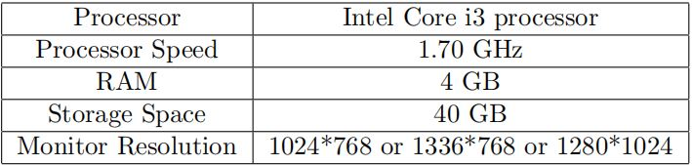
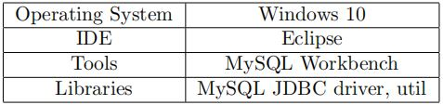
REQUIREMENT ANALYSIS
Hardware Requirements:
The Hardware requirements are very minimal and the program can be run on most of the machines.
Software Requirements:
The software requirements are description of features and functionalities of the system.

Slide 4
FUNCTIONAL AND NON FUNCTIONAL REQUIREMENTS
Functional Requirements:
Employee details Validation: The system should be able to validate employee details. It should check the salary and deductions of each employee for accuracy .
Employee Details Storage: The system should be able to store employee details in a MySQL database. It should ensure that the records are stored securely.
CRUD Operations: The system should implement the CRUD (Create, Read, Update, Delete) operations for employee details. Users should be able to add, view, update and delete an employee detail.

Slide 5
Non-Functional Requirements:
Security: The system should be secure and protect the employee details from unauthorized access and misuse.
Performance: The system should perform efficiently, with minimal delays in any processing. It should be able to handle a large number of employee records without affecting the system’s performance.
Scalability: The system should be scalable as per the requirements and be able to handle an increasing number of records as the business grows.
Usability: The system should be easy to use and navigate. Users should be able to understand and use the system without extensive training.
Reliability: The system should be reliable and available 24/7. It should have backup and recovery mechanisms in place to ensure that the records are not lost in case of system failures.

Slide 6
DESIGN AND METHODOLGY
The program mainly consists of 5 modules namely: Main class, Class JDBC Connection, Class Employee, Employee Interface and Class for Employee Implementation.
In the main class, initially the menu is displayed which asks the user his interest of operation.
The class DBConnection mainly helps in connecting to our MySQL server and our program thereby creating the connectivity bridge for accessing the database through our source code.
The class Employee consists of a constructor to initialize the attributes mentioned specific to the employees. It also has getters and setters used to access and assign these attributes during the computations.
The interface EmployeeIntr is created which specifies all the methods required for the operations to be performed and are declared here.
The class EmployeeImpl basically contains all the definitions of the methods declared in the above mentioned interface.

Slide 7
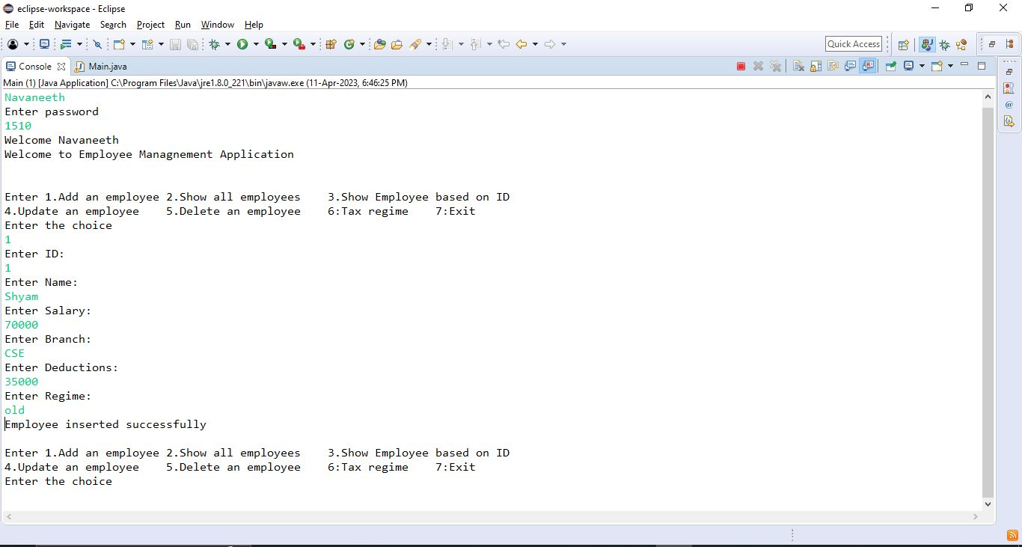
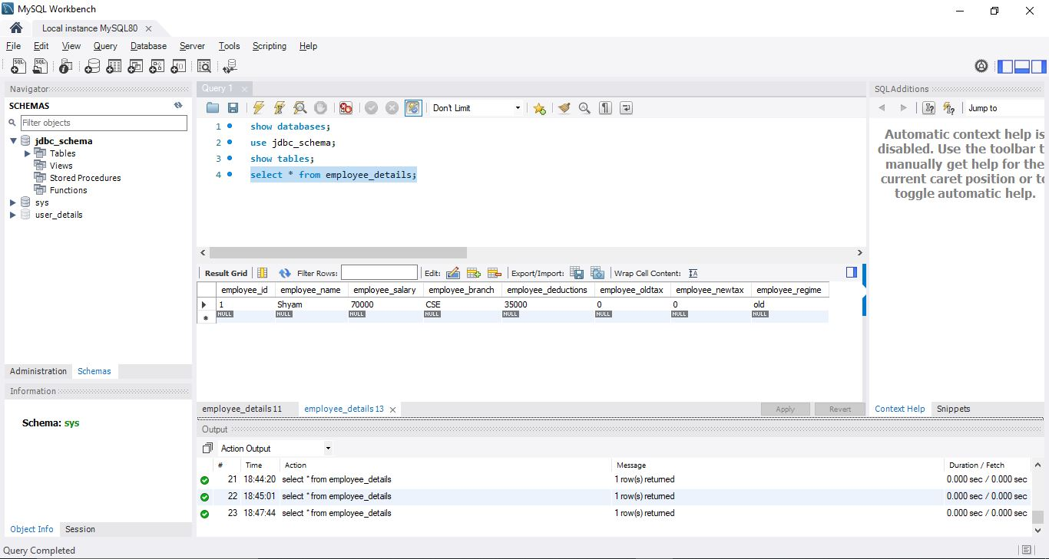
The database updated in MySQL Workbench
Inserting a record through the console

Slide 8
CONCLUSION AND FUTURE ENHANCEMENTS
The employee management system was developed using an iterative and incremental software development methodology. The development process was divided into multiple phase including requirements gathering an employee, design, implementation and testing.
Coming to the future enhancements on this project, we further look up to consider each and every forms of deductions individually so that it gives an extra edge and more accuracy in choosing a better tax regime to the employee.
Adding a front-end application for this project for the better user experience are also being looked up.

